Slide 1
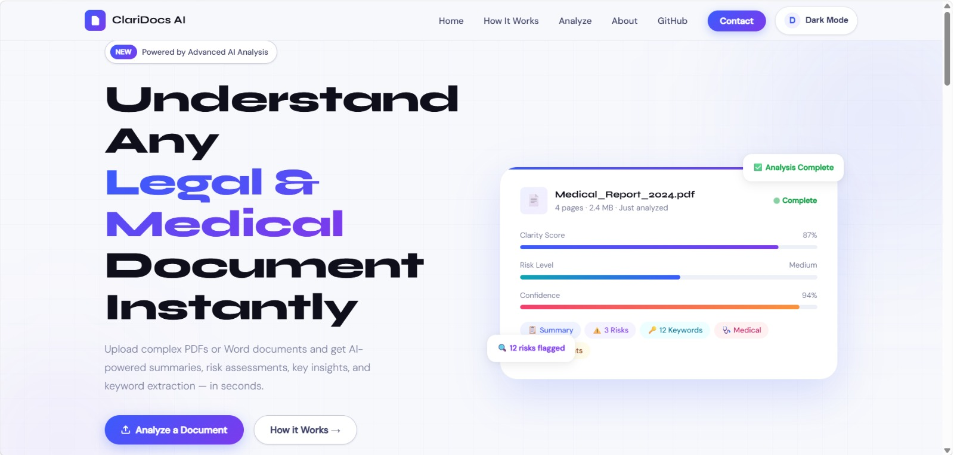
ClariDocs AI
An Efficient and Lightweight ML System for
Automated Document Analysis, Categorization, and Risk Detection
Team Details
M Koushik – 2403A52258 – Batch 10
Mohammed Eliyas – 2403A52257 – Batch 10
Hrishikesh Sharma – 2403A52274 – Batch 10
Role: Full Stack and Machine Learning Integration

Slide 2
Problem Statement
Current Challenges
Our Solution
Exponential growth of unstructured text in legal, medical, insurance domains
Manual review is slow, costly, error-prone, creating operational bottlenecks
Regulatory compliance demands rapid, accurate document triage
LLMs require heavy compute, high latency, and risk sensitive data privacy
Organizations need instant insights without expensive infrastructure
Lightweight, fully local ML pipeline using TF-IDF + Logistic Regression
Real-time classification, summarization, and risk detection <1s
Zero data leaves the host machine – 100% privacy compliant
Runs on commodity hardware, no GPU or cloud APIs needed
Democratizes advanced document analysis for any organization

Slide 3
Stakeholders
Legal Teams
Contract review, liability detection, compliance checks
Healthcare Providers
Clinical report summarization, PHI-safe analysis
Insurance Companies
Policy categorization, risk flagging, claims triage
Research Institutions
Rapid literature sorting from arXiv & journals
SMBs & Enterprises
Privacy-preserving analysis on standard laptops

Slide 4
Dataset and Model Discussion
Training Corpus – 320 Balanced Docs
Model Pipeline
Legal Contracts: CUAD dataset from Hugging Face – real clause examples
Medical Reports: MTSamples – clinical transcriptions
Insurance Policies: InsuranceQA-v2 – domain vernacular
Research Papers: Live arXiv API – CS abstracts
80 samples per class ensures balanced, unbiased training
1. TF-IDF Vectorizer: 20,000 unigram/bigram features
2. Logistic Regression: Fast, interpretable, deterministic
3. Extractive Summary: TF-IDF sentence ranking
4. Risk Detection: Domain-specific RegEx rules
5. Semantic Query: Cosine similarity on document chunks
All processing <1s on CPU

Slide 5
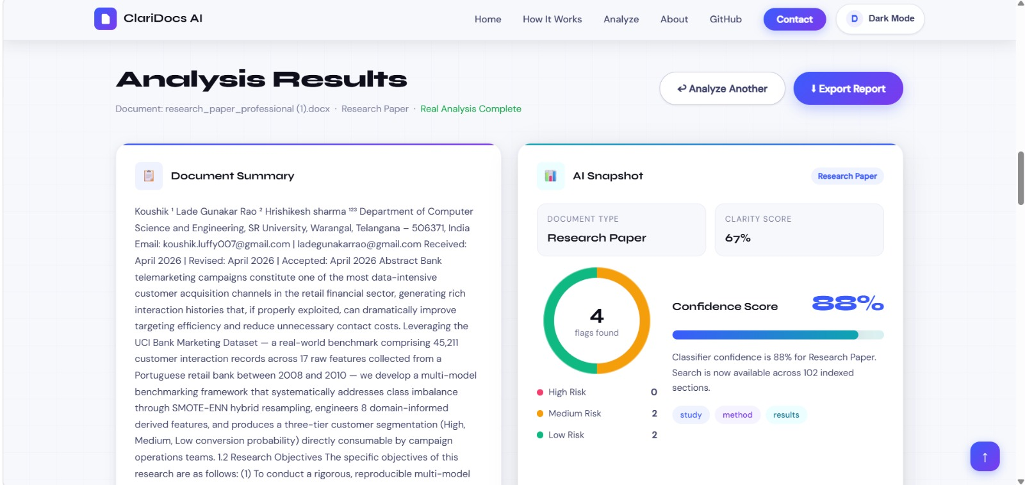
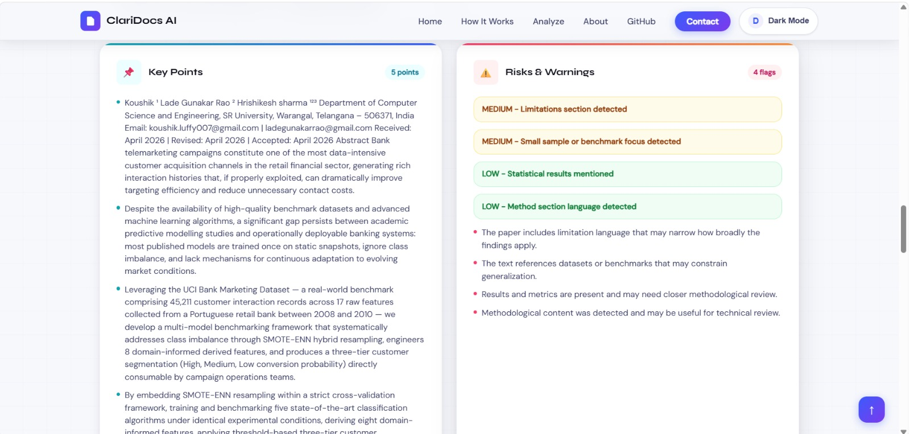
Results
Key Outcomes: High accuracy from distinct vocabularies
• Sub-second latency vs. multi-second LLM APIs
• 100% local privacy • Extractive summaries cut reading time ~70%
• Deterministic RegEx flags for auditability

Slide 6
Application Architecture
Tech Stack
User Workflow
Backend: Python + FastAPI – async, type-safe endpoints
ML Pipeline: Scikit-learn TF-IDF + LogisticRegression
Frontend: Vanilla HTML/CSS/JS – zero dependencies
File Support: PDF, DOCX, TXT with client/server parsing
Deployment: Docker-ready, runs on any VM or localhost
Security: No external API calls, no data transit
1. Upload document via drag-and-drop
2. Automatic classification into Legal/Medical/Insurance/Research
3. Extractive summary + key point extraction
4. Domain-specific risk scan with RegEx
5. Semantic search: query document sections instantly
6. Export results or analyze another file

Slide 7
Conclusions
Project Impact
Proved classical NLP remains viable for targeted document intelligence without LLMs
ClariDocs AI automates triage: classification, summarization, and risk surfacing in <1s
Eliminates infrastructure cost, latency, and privacy risks of cloud LLMs
Delivers enterprise-grade functionality on commodity hardware – democratizes access
Deterministic pipeline ensures auditable, explainable results for compliance
Future Work: Expand to finance & HR domains, add OCR for scanned PDFs, optional LLM hybrid mode for edge cases

Slide 8
References
Pedregosa, F., et al. (2011). Scikit-learn: Machine Learning in Python. Journal of Machine Learning Research, 12, 2825-2830.
Salton, G., & Buckley, C. (1988). Term-weighting approaches in automatic text retrieval. Information Processing & Management, 24(5), 513-523.
Hendrycks, D., et al. (2021). CUAD: An Expert-Annotated NLP Dataset for Legal Contract Review. arXiv:2103.06268.
FastAPI Documentation. Building high-performance APIs with Python. https://fastapi.tiangolo.com/
Datasets: CUAD (Hugging Face), MTSamples, InsuranceQA-v2, arXiv API

